Slide 1
Introduction to Artificial Intelligence Session 01
Course : COMP6065001 Artificial Intelligence
Effective Period : September 2023

Slide 2
Learning Outcomes
At the end of this session, students will be able to:
LO 1: Describe what is AI and identify the concept of the intelligent agent

Slide 3
Outline
Artificial Intelligence (AI)
Foundations of AI

Slide 4
Artificial Intelligence
Artificial intelligence (AI) attempts not just to understand but also to build intelligent entities
Stuart J Russel, Professor in Univ. of California Berkeley
Peter Norvig, Director of Research

Slide 5
Artificial Intelligence
Just as the Industrial Revolution freed up a lot of humanity from physical drudgery, I think AI has the potential to free up humanity from a lot of the mental drudgery [source]
Andrew Ng, Adjunct Professor in Stanford

Slide 6
Artificial Intelligence
AI is going to bring major shifts in society through developments in self-driving cars, medical image analysis, better medical diagnosis, and personalized medicine [source]
Yann LeCun, Director of AI Research, Facebook

Slide 7
What is AI?
Thinking Humanly “The exciting new effort to make computers thinks … machine with minds, in the full and literal sense” (Haugeland, 1985) | Thinking Rationally “The study of mental faculties through the use of computational models” (Charniak and McDermott, 1985)
Acting Humanly “The study of how to make computers do things at which, at the moment, people are better” (Rich and Knight, 1991) | Acting Rationally “Computational Intelligence is the study of the design of intelligent agents” (Poole et al., 1998)

Slide 8
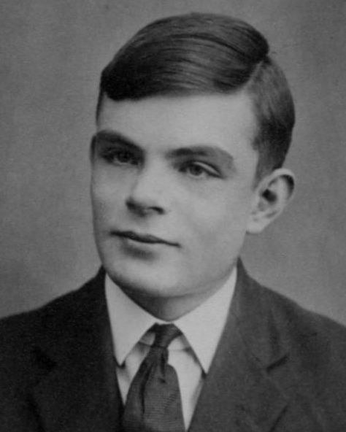
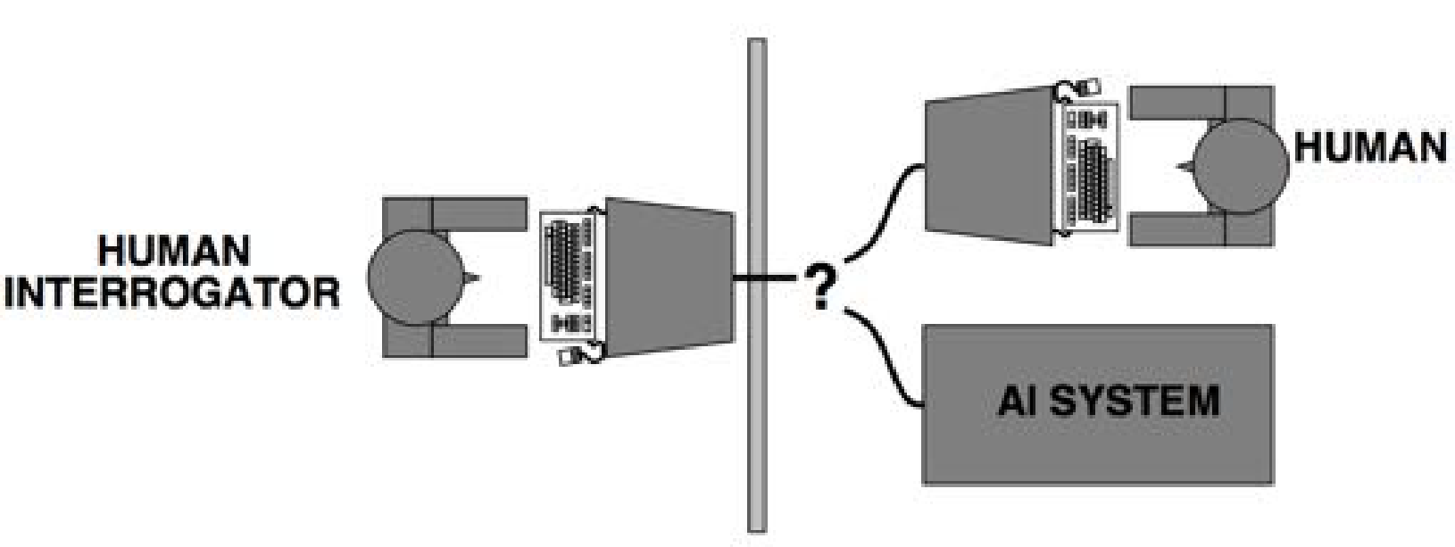
Acting humanly
The Turing Test (Alan Turing, 1950)
Instead of duplicating an exemplar, it is more useful and important to study the principles of the intelligence

Slide 9
Thinking humanly
The cognitive modelling
Part of cognitive science
Once we have a sufficiently precise theory of the mind, it becomes possible to express the theory as a computer program

Slide 10
Thinking rationally
The “laws of thought” or logic
Aristotle was one of the first to introduce logic or “right thinking”
Syllogisms provided patterns for argument structure
Correct premises = correct solutions
Example:
He is a boy; All boys are handsome;
Therefore, he is handsome

Slide 11
Acting rationally
Rational behavior: doing the right thing
The right thing: that which is expected to maximize goal achievement given the available information
Example:
Given money Rp. 100.000, you have to buy a birthday gift
Which one will you choose? Which one is more rational?
Bracelet (Rp. 100.000) or Ring (Rp. 150.000)

Slide 12
Rational Agent
An agent
Just something that acts
A rational agent
One that acts as to achieve the best (expected) outcome
The rational-agent approach has two advantages:
It is more general than the “laws of thought” approach
it is more amenable to scientific development

Slide 13
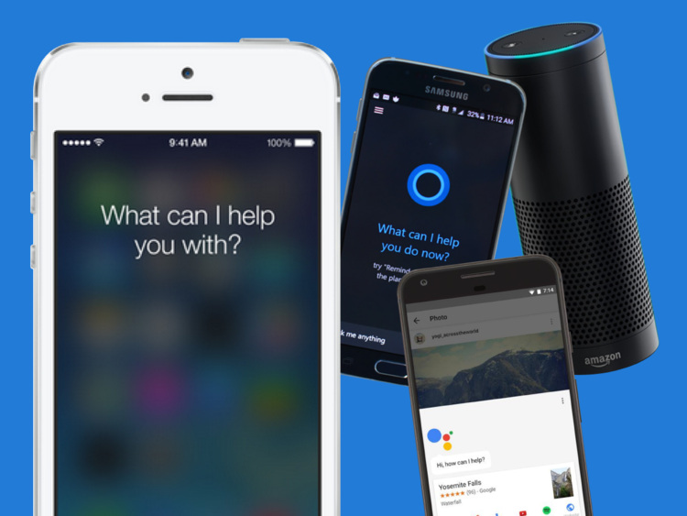
AI Applications
Speech Recognition
Virtual Assistants
Siri (Apple)
Google Now
Cortana (Microsoft)
They helps us to arrange meetings, check weather, do a phone call, send a message, etc.
[source]

Slide 14
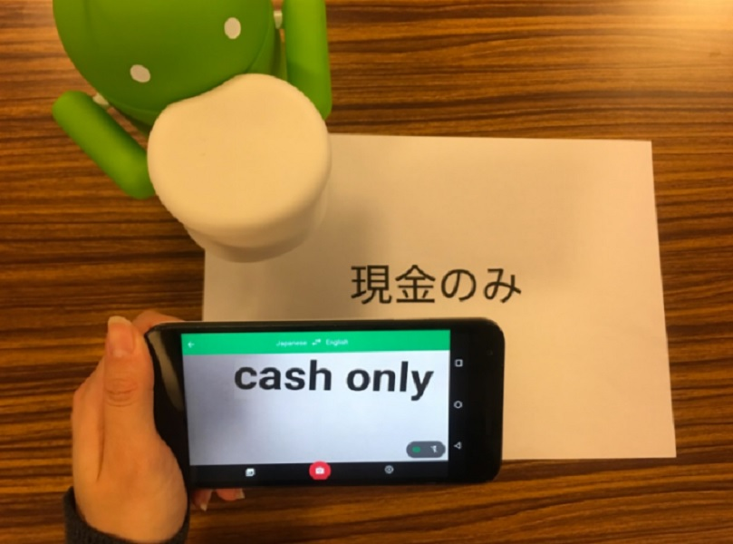
AI Applications
Machine Translation
Google Translate
No more bringing dictionary when travelling
[source]

Slide 15
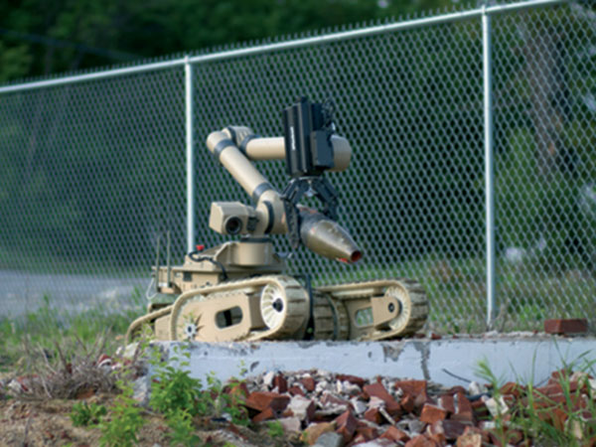
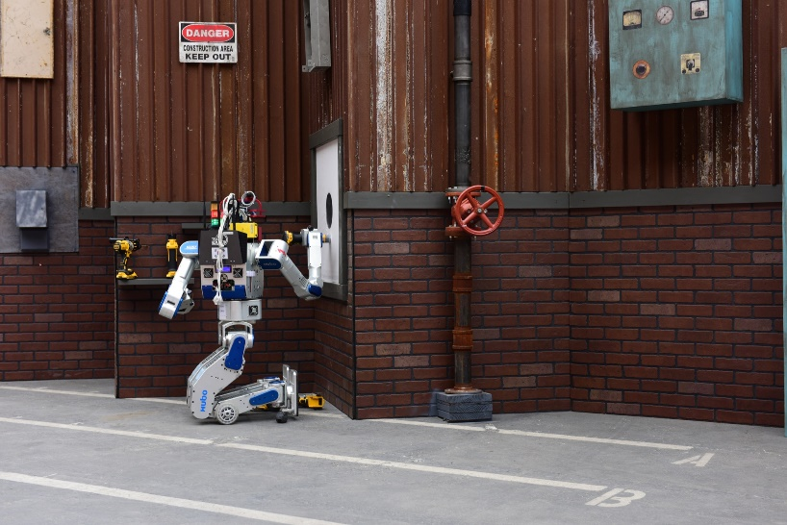
AI Applications
Robotics
Several robots were sent to Fukushima nuclear tragedy to perform various tasks (Left)
Hubo: A KAIST Robot who wins the DARPA Robot Challenge (Right)
[source]
[source]

Slide 16
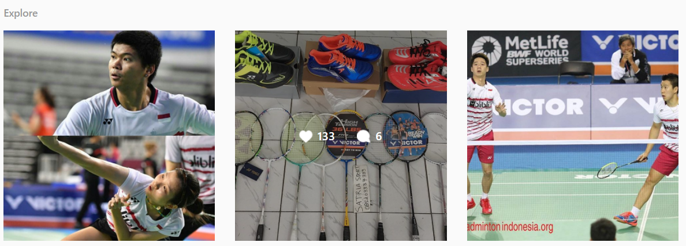
AI Applications
Recommendation Systems
AI helps to provide items / photos / various things based on our social activities
Instagram Explore / Search Feed
If we follow many badminton accounts, they show:

Slide 17
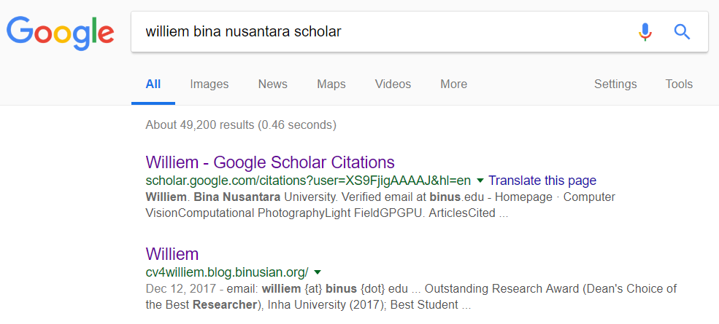
AI Applications
Search Engines
Google’s search engines algorithm is designed to show internet pages of our interests in a blink of eyes

Slide 18
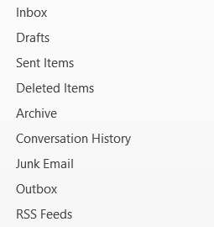
AI Applications
Email
Spam/Junk email detection
Sender:
asdadsa@asda.com
sdajhda@afasa.com
asdjhaksdah@asffa.com
Title:
Hi, I need your help!
1 million dollar for you now!
[blank]
Content:
Congrats, you won XXX Awards. Please tell me your name, address, birth date, and telephone number to xxx_awards@gmail.com

Slide 19
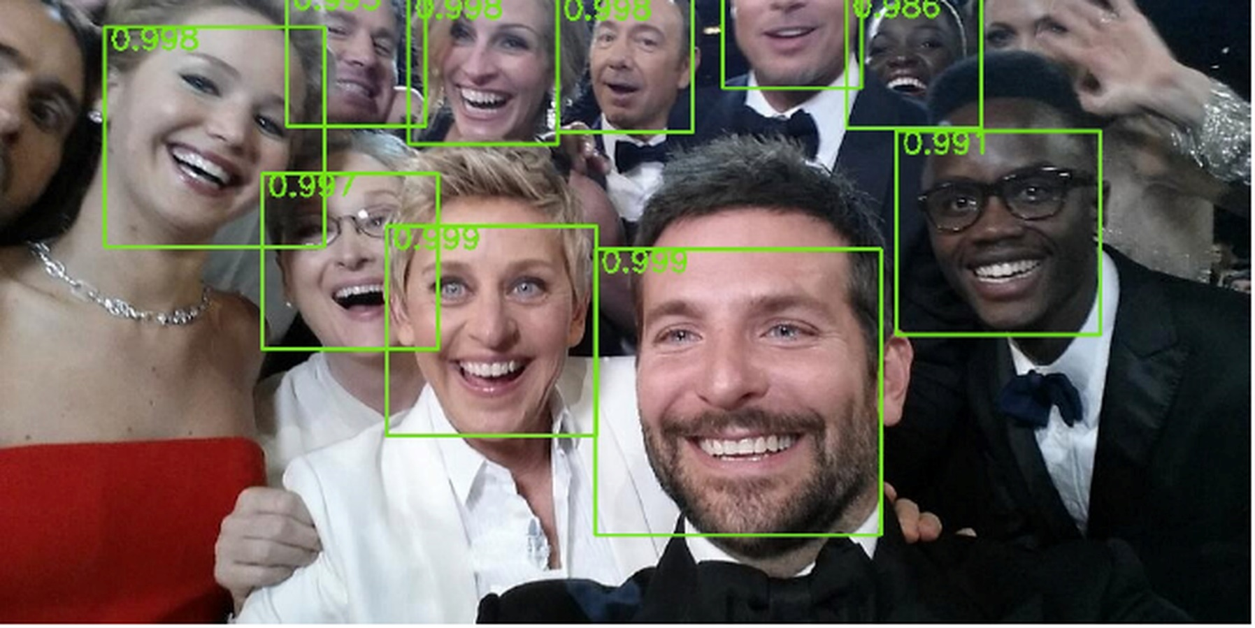
AI Applications
Face Detection
[source]

Slide 20
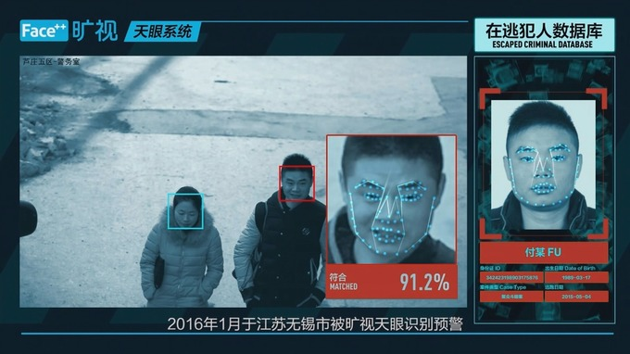
AI Applications
Face Recognition
China’s facial recognition technology to identify the citizen
[source]

Slide 21
AI Applications
Games
Chess (1997): Kasparov vs. IBM Deep Blue
Powerful search algorithms
Jeopardy! (2011): Humans vs. IBM Watson
Natural language processing and information extraction
Go (2016): Lee Sedol vs. Google AlphaGo
Deep learning + reinforcement learning + search algorithms!
Future: 5 vs 5 AI for Dota

Slide 22
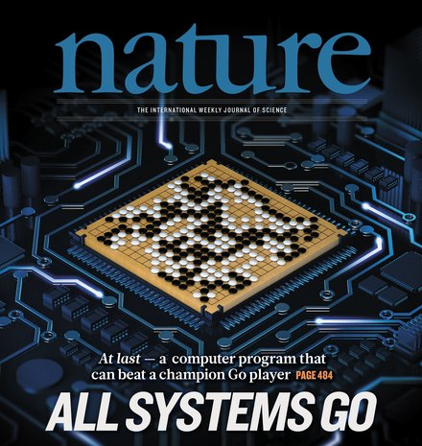
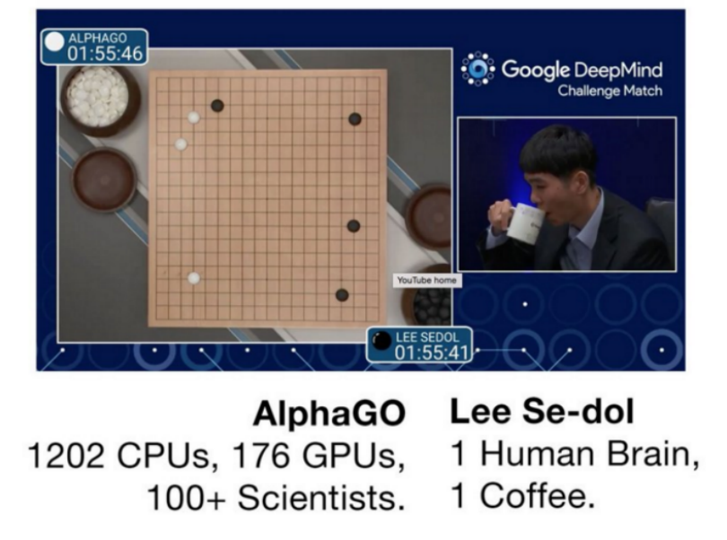
AI Applications
Games
March 2016, AlphaGo beat Lee Sedol (4 vs 1)
December 2016, AlphaGo beat Ke Jie (3 vs 0)
[source]
[source]

Slide 23
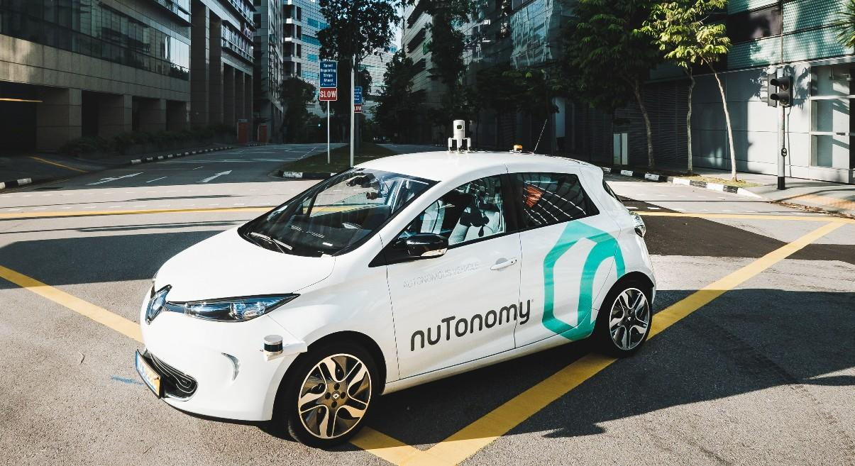
AI Applications
Autonomous Driving
NuTonomy: A robo-taxi service in Singapore
[source]

Slide 24
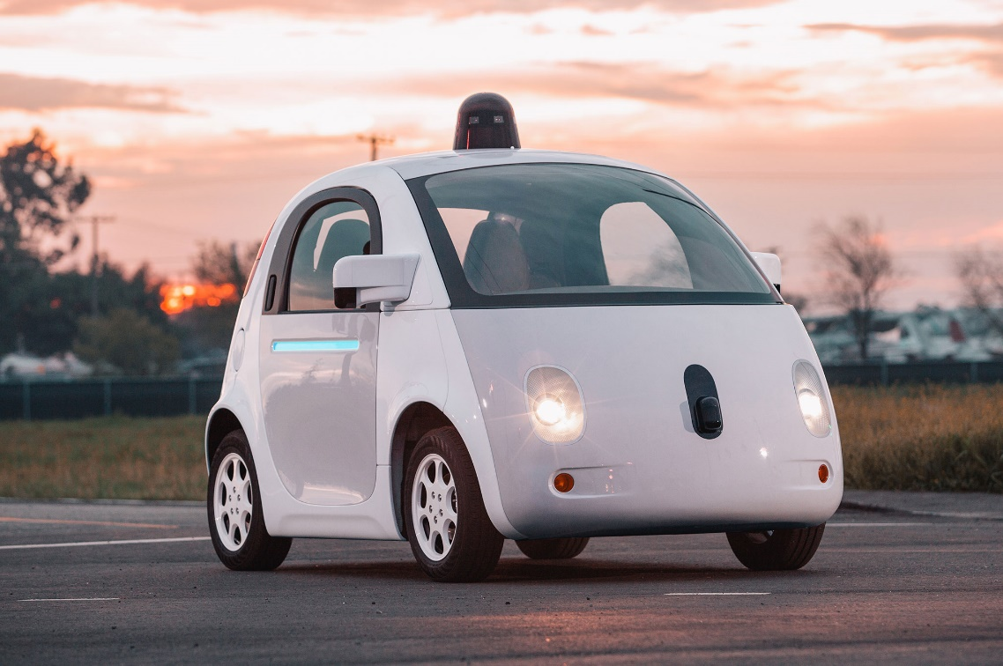
AI Applications
Autonomous Driving
Waymo: An autonomous car company under Alphabet, Inc. (Google’s parent company)
[source]

Slide 25
Foundation of AI
Philosophy
Linguistics
Mathematics
AI
Control Theory and Cybernetics
Economics
Computer Engineering
Neuroscience
Psychology

Slide 26
Foundation of AI
Philosophy
Logic, methods of reasoning
Foundations of learning, language, rationality
Mathematics
Logic: Formal representation and proof
Algorithms, computation, (un)decidability, (in)tractability
Probability

Slide 27
Foundation of AI
Economics
Formal theory of rational decisions
Neuroscience
Plastic physical substrate for mental activity
Psychology
Adaptation
Phenomena of perception and motor control
Experimental techniques (psychophysics, etc.)

Slide 28
Foundation of AI
Computer Engineering
How can we build an efficient computer to build AI program?
Control Theory and Cybernetics
Simple optimal agent designs
Linguistics
Knowledge representation
Grammar

Slide 29
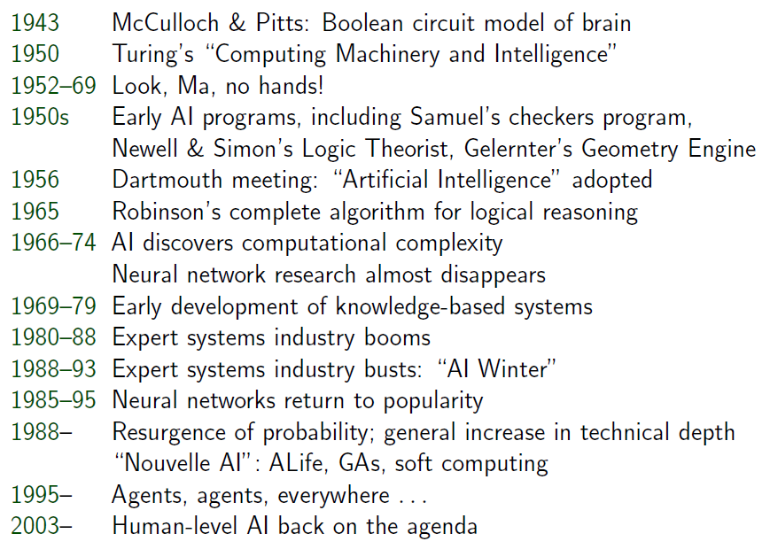
Brief History of AI

Slide 30
References
Stuart Russell, Peter Norvig. 2010. Artificial Intelligence : A Modern Approach. Pearson Education. New Jersey. ISBN:9780132071482

